Slide 1
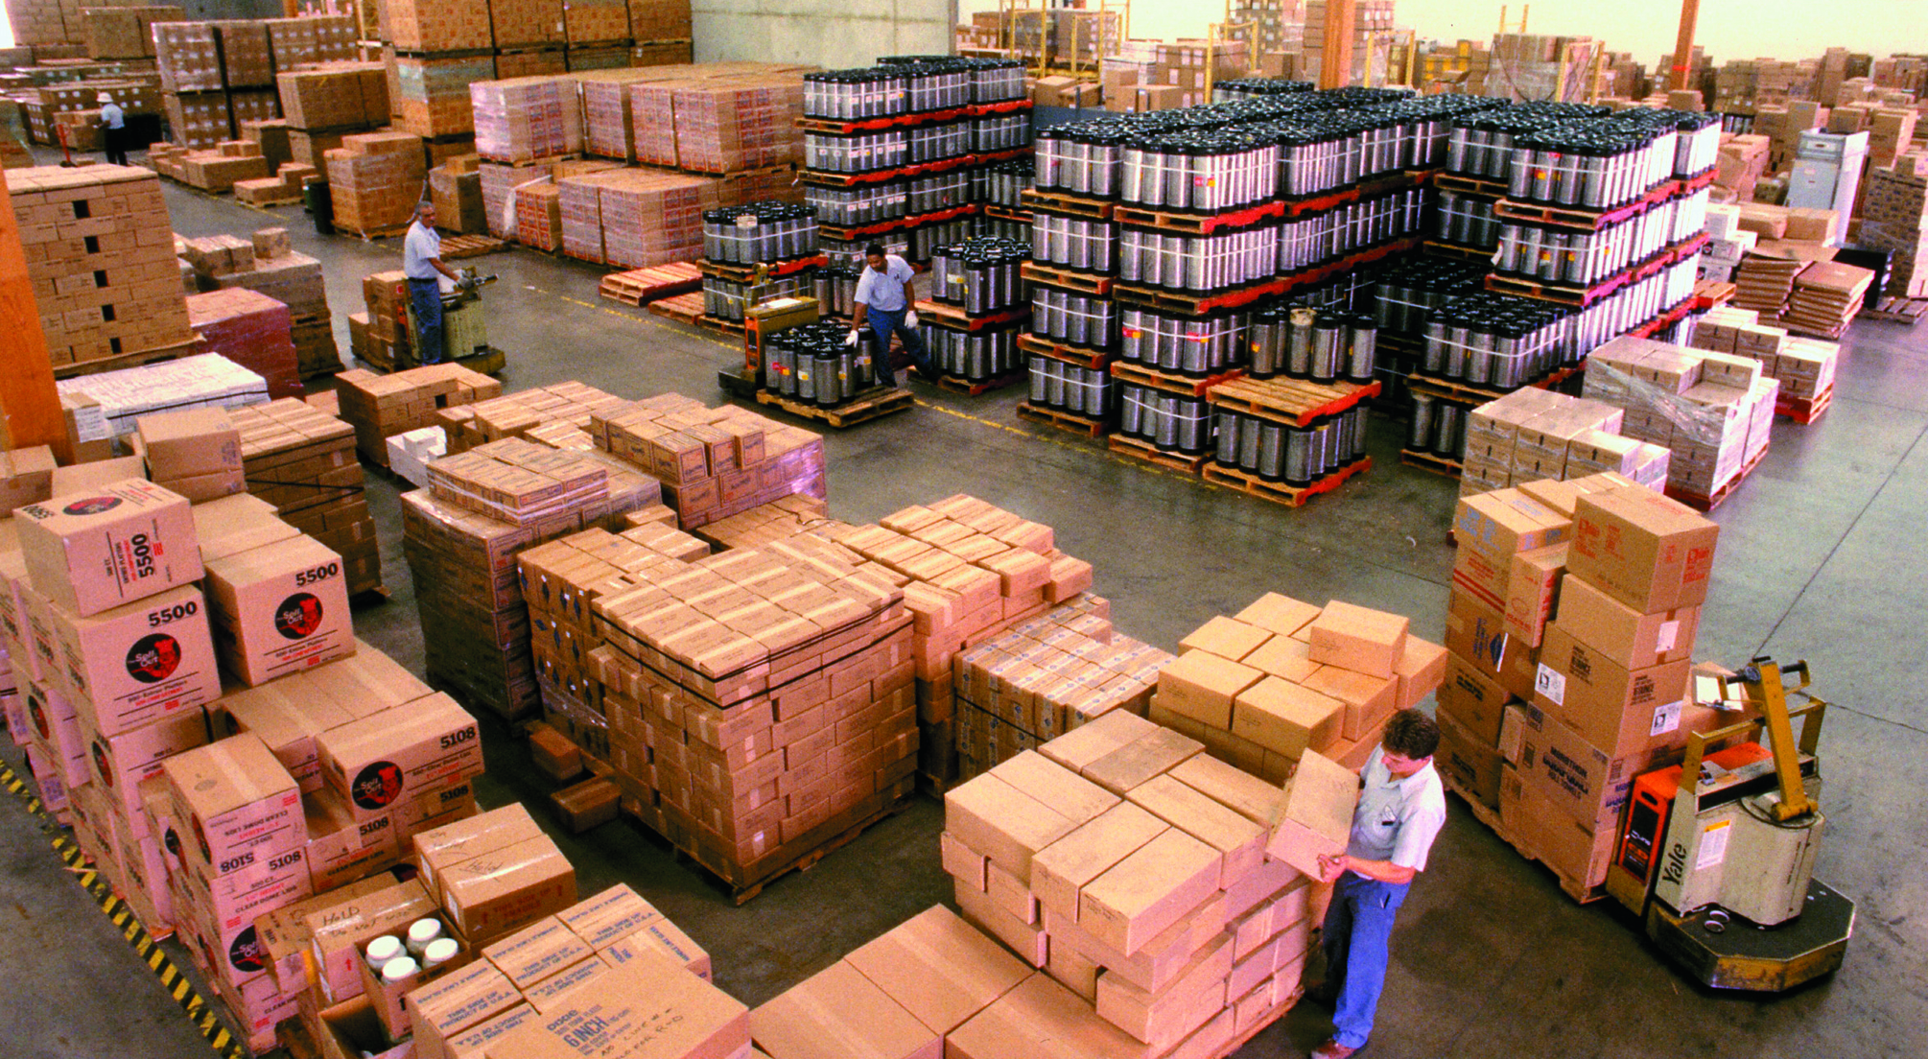

Freight Management with JavaFX on the NetBeans Rich Client Platform
Rob Terpilowski
Lynden, Inc.

Slide 2
About Me
Application Architect at Lynden, Inc.
Technical lead for our freight planning and management application, “FMS”.
Notes:
About Me / Lynden
Application Architect. Technical lead for our freight planning and management application, named FMS.

Slide 3


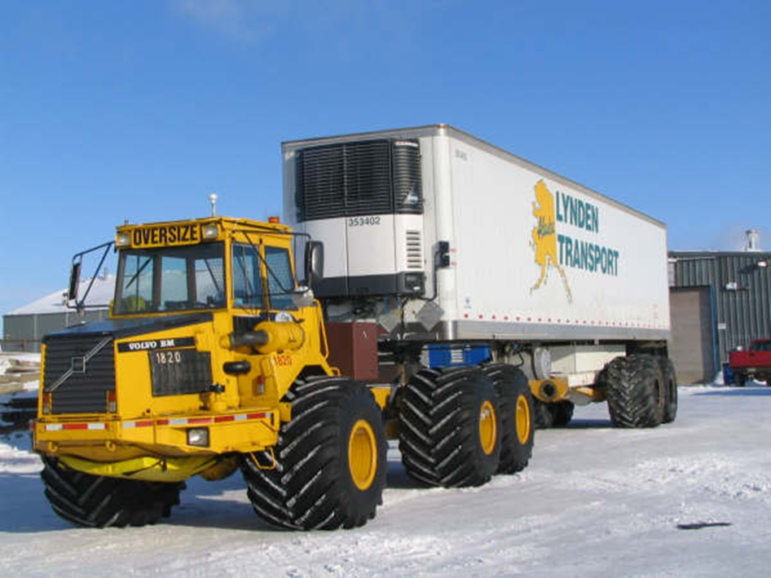
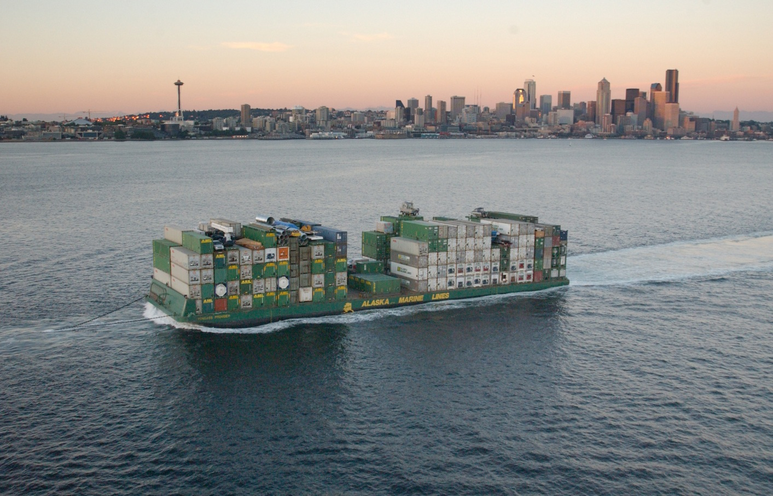
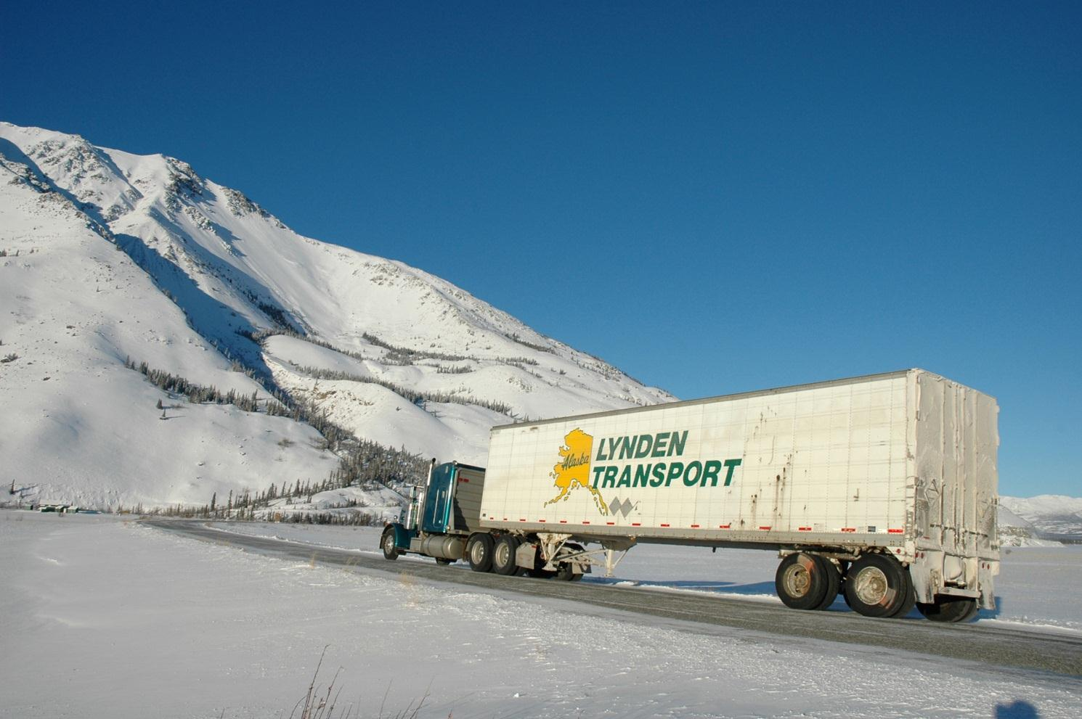
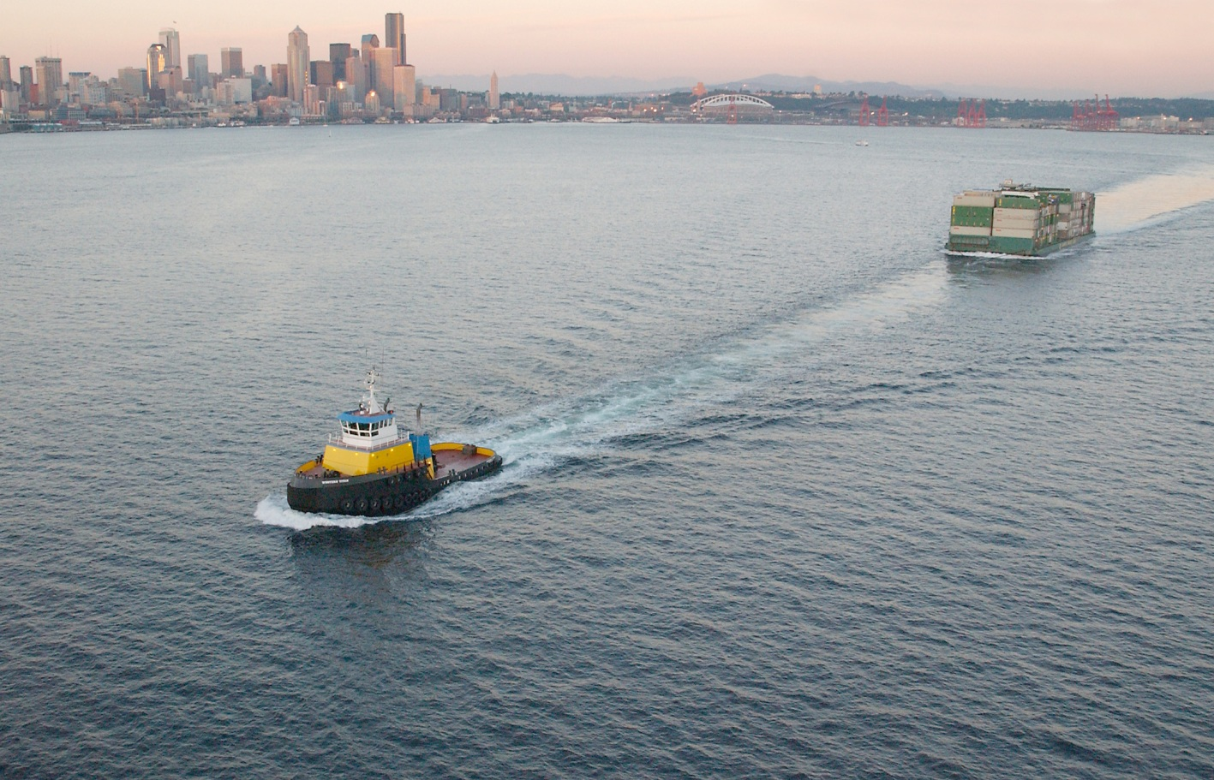
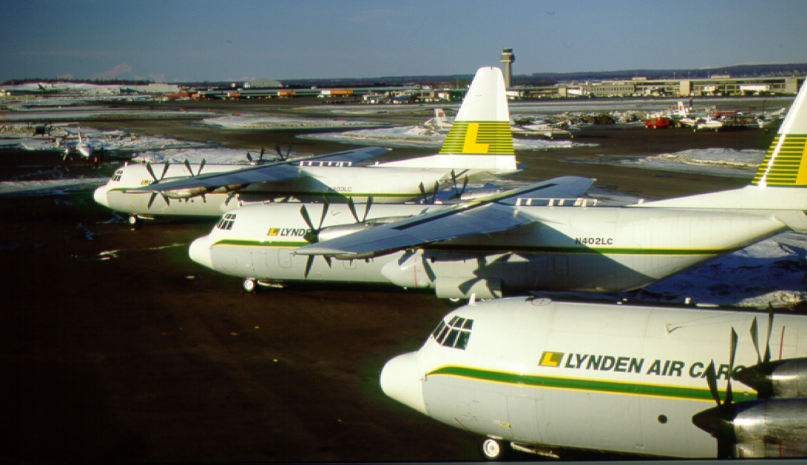






Operating Companies
Notes:
Lynden
Based in Seattle, multi-modal freight and logistics company specializing in shipping to/from Alaska.
Lynden, Inc. parent company owns more than 50 different operating companies, mostly in the Alaskan market, but some companies ship worldwide.
Warehouse terminals across the world and want to give our warehouse managers the ability to plan for the arrival and delivery of freight.
The currently use things such as white boards with scrap paper and magnets, and a bit more modern spreadsheets.

Slide 4

The Problem
Where’s my freight???
Notes:
Trying to answer a seemingly simple question….
Help warehouse managers plan for freight arrival and departure so that they can manage and optimize resources including personal and equipment. Ability to track the current location of a customer’s shipment.

Slide 5
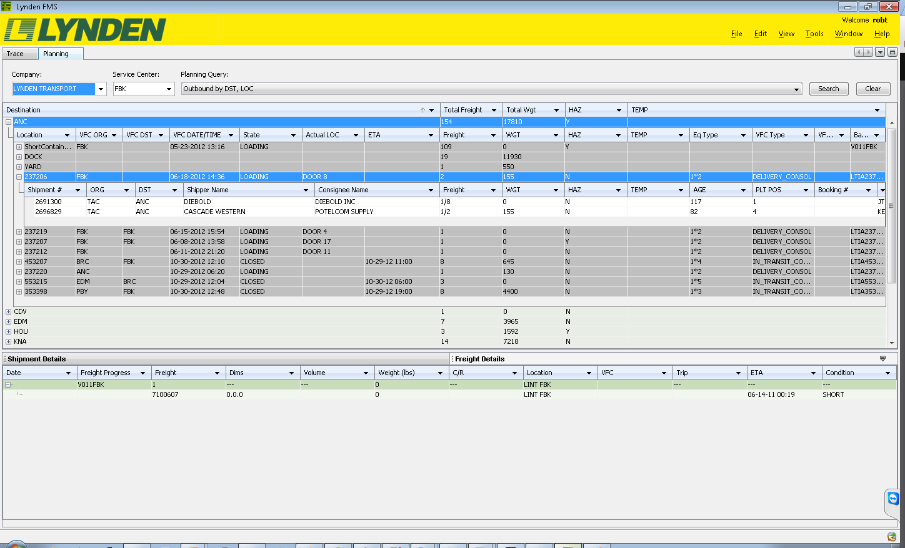
Freight Management RCP App with Swing
Notes:
We set out to build a Freight Management Application (FMS). Based on the netbeans rich client platform. Currently with 2 main modules. “Trace” which will be used by customer service personel and “Planning” which will be used by our warehouse managers for planning for inbound and outbound freight.
We are currently using Netbeans RCP with Swing components including commercial components from JideSoft such as a nested tree table.
Main problem from the users was the amount of data displayed on the screen was overwhelming and difficult to track and navigate.
The next release of the Planning module will contain additional features for planning inbound freight. We wanted to take this as an opportunity to streamline the UI.
JavaFX seemed to be the logical choice since Oracle seems to be throwing its weight behind it as the next generation UI toolkit.

Slide 6

Extreme Makeovers
Notes:
Started with designing some potential screens to enhance the inbound freight planning process.
Using SceneBuilder, FXML, and CSS, some concept screens were created and tweaked.
Netbeans 7 support for JavaFX allows you to open FXML files either in the default text editor or in the Scene Builder WYSIWYG designer.

Slide 7
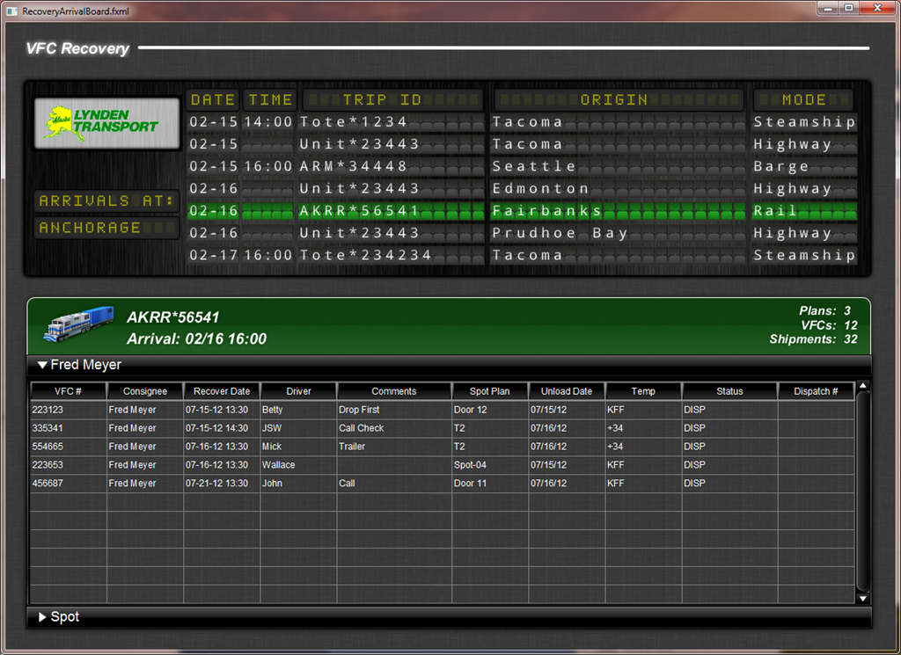
Notes:
Quite a bit different UI concept. Able to create a screen that resembles an airport or train arrival board. Used components from the JFXtras open source UI library.
Designed partially in Java and partially in Java and partially in FXML with SceneBuilder in addition to CSS.

Slide 8
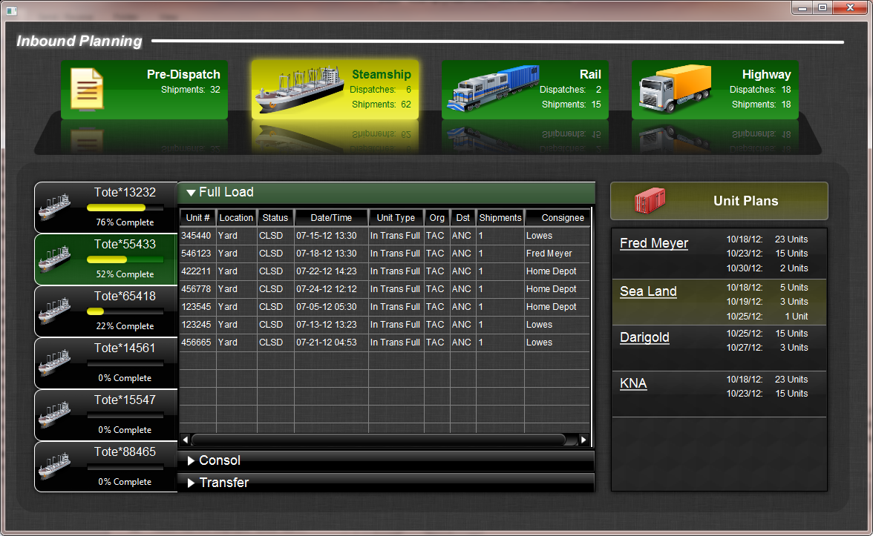
Notes:
Next iteration:
Different modes, ship, rail, highway, selectable tabs at top of UI.
Effects such as reflections, gradients, glow, translucency, which were possible to do in Swing, but a major pain in the ass, are baked into JavaFX.
Fan of eye candy, but can’t justify to management the increase in hours to make an application as polished as this with swing, whereas with JavaFX these effects are standard and can be styled with CSS.

Slide 9
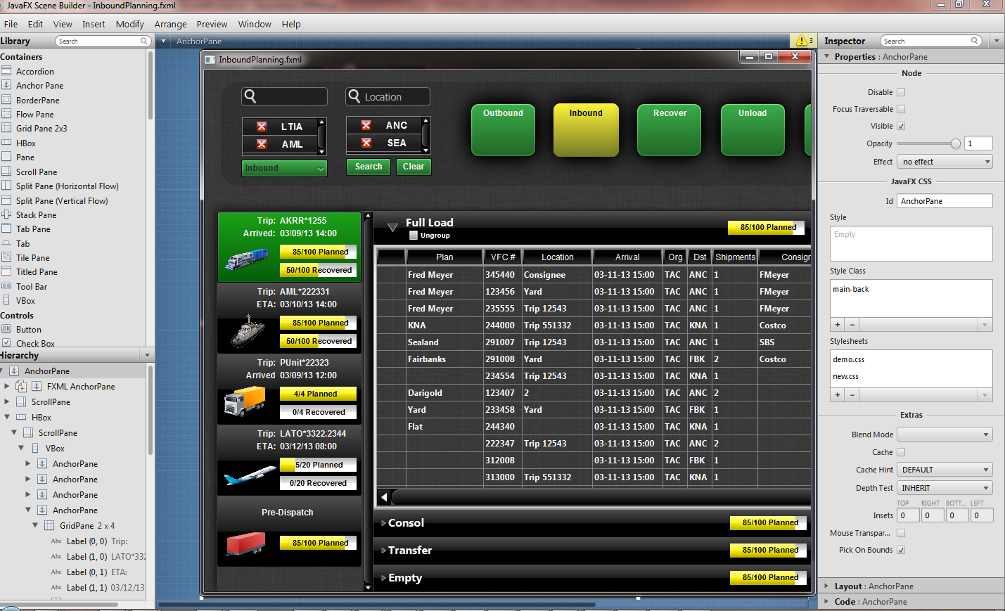
JavaFX UI Design with Scene Builder
Notes:
Scene Builder
WYSYWG

Slide 10
Adding JavaFX to the Swing UI
public FXPlanningTopComponent() {
initComponents();
setName(Bundle.CTL_FXPlanningTopComponentTopComponent());
setToolTipText(Bundle.HINT_FXPlanningTopComponentTopComponent());
Platform.setImplicitExit(false);
Platform.runLater(new Runnable() {
public void run() {
Parent root;
try {
root = FXMLLoader.load(
getClass().getResource("/com/lynden/planning/ui/InboundPlanning.fxml"));
JFXPanel jfxPanel = new JFXPanel();
jfxPanel.setScene(new Scene(root));
} catch (IOException ex) {
Exceptions.printStackTrace(ex);
}
}
});
setLayout(new BorderLayout());
add(jfxPanel, BorderLayout.CENTER);
}

Slide 11
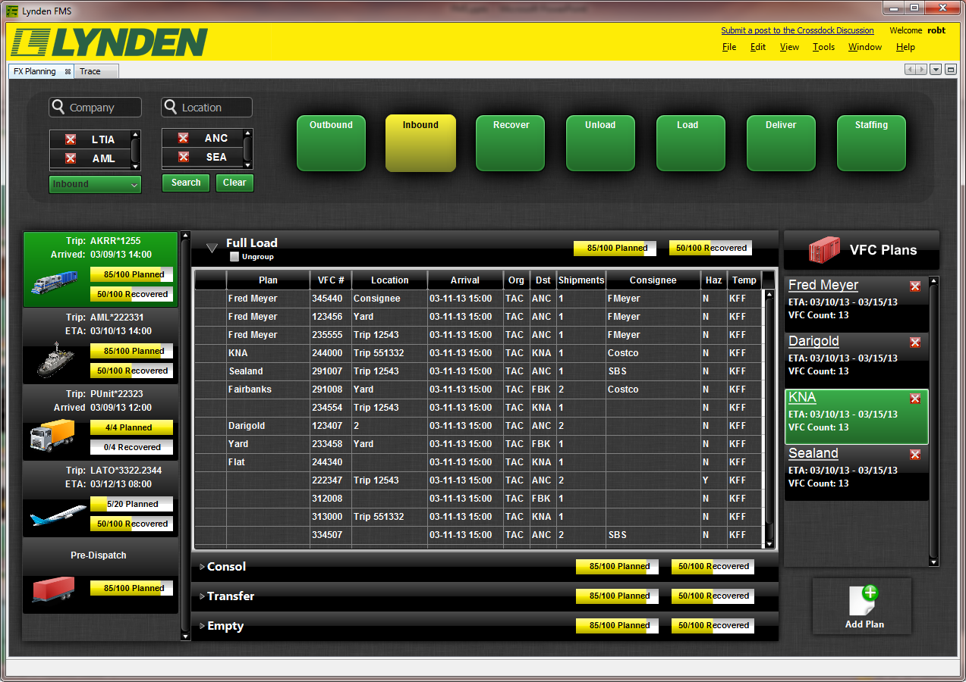
JavaFX in a NetBeans RCP App

Slide 12
Contact Info
Rob Terpilowski
Email: robt@Lynden.com
Twitter: @RobTerp
Blog: http://rterp.wordpress.com

